Slide 1
Game Programming with Elm
Splash 2016
Notes:
How many of you have programmed before? What languages? Most of these are imperative and/or object-oriented languages, while Elm is a functional programming language.
It’s like a different language family, you have to use a different way of thinking. Don’t worry if you haven’t had programming experience, you won’t have any habits to break!

Slide 2
Game programming with Elm
http://bit.ly/elmclass
http://www.elm-lang.org

Slide 3

Notes:
Turn to the person next to you and introduce yourself. This is your coding buddy. If you have a question and I'm not free, ask your coding buddy first! There's this thing called "teddy bear programming": when debugging it helps to explain your code out loud to a teddy bear. Well, you'll be each other's real life teddy bears.

Slide 4
Why Elm?

Slide 5
Elm
Elm is a functional reactive programming language.
Functional:
Functions are building blocks.
Quick to program.
Type safety eliminates runtime errors.
Purity: Separates program logic from outside world.
Reactive:
Deals with signals (key presses, clicks…) coming from outside world.

Slide 6
Why functional?
Python
def quickSort(arr):
less = []
pivotList = []
more = []
if len(arr) <= 1:
return arr
else:
pivot = arr[0]
for i in arr:
if i < pivot:
less.append(i)
elif i > pivot:
more.append(i)
else:
pivotList.append(i)
less = quickSort(less)
more = quickSort(more)
return less + pivotList + more
Elm
quicksort : List comparable -> List comparable
quicksort list =
case list of
[] -> []
pivot :: rest ->
let lower = filter (\n -> n <= pivot) rest
higher = filter (\n -> n > pivot) rest
in
quicksort lower ++ [pivot] ++ quicksort higher

Slide 7
Why Elm?
Clear and concise.
Few runtime errors.
Hot-swapping.
Time-travel debugging. (http://debug.elm-lang.org/edit/Mario.elm)
Notes:
When people write apps in Elm, often they write part of it in Elm, part of it in another language, and when the program crashes, it’s the non-Elm part.
Something about the language just makes the process of coding easier.
http://localhost:8000/elm-examples/Mario.elm?debug

Slide 8
Basic programming
Notes:
A subtle difference: the program isn’t so much a list of commands as telling the computer how to obtain the result.

Slide 9
Basic programming
Basics
Primitive types: Bool, Int, Float, Char, String
http://elm-lang.org/learn/Syntax.elm
Exercise: BasicEx.elm, FizzBuzz.elm
Lists
Lists.elm
Recursion: ListCases.elm
Datatypes (Union types, records)
Money.elm
Movement.elm
Putting it all together: ScoresAndLives.elm
Notes:
A subtle difference: the program isn’t so much a list of commands as telling the computer how to obtain the result.
type Gender = Male | Female
type List a = Empty | Cons a (List a)
type alias Person = {name : String, gender : Gender, age : Int, married : Bool}

Slide 10
What’s different about functional?
Variables are immutable.
let x = x + 1. NO.
let x’ = x + 1.
Functions always return the same value (purity).
Functions can take functions as arguments
Partial application
Notes:
A subtle difference: the program isn’t so much a list of commands as telling the computer how to obtain the result.
-- NO: statements do not go in bodies of `if` statements. Values do.
if x > 0
then string = "positive"
else string = "not positive"
-- YES
string = if x > 0
then "positive"
else "not positive"

Slide 11
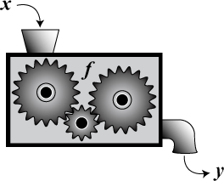
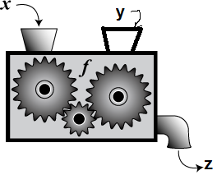
Functions are first class-citizens!
f : A -> B
f : A -> B -> C

Slide 12
Lists and Higher-order Functions
Replacements for looping
map : (a -> b) -> List a -> List b
map2 : (a -> b -> c) -> List a -> List b -> List c
foldl : (a -> b -> b) -> b -> List a -> b
Notes:
map (\x -> x+1) [1, 2, 3] gives [2, 3, 4]
M
foldl (+) 0 [1, 2, 3] gives 6
foldl (\x y -> if x then y + 1 else y) 0 [True, True, False, False, True]

Slide 13
More datatypes
Union types: types that can take one of several values
type Suit = Club | Diamond | Spade | Heart
type Status = HasMoney Float | Bankrupt
Records
type alias Card = {value : Int, suit : Suit}
type alias Model = {position : Vector, facing : Vector}
type alias Vector = {x : Int, y : Int}
Notes:
TODO: need example like List a

Slide 14
Quiz
Is an element in the list?
a -> List a -> Bool
Filter a list based on a condition.
filter : (a -> Bool) -> List a -> List a
Make a list by repeating an element n times.
repeat : Int -> a -> List a
Find the first element of a list.
head : List a -> Maybe a
case (head li) of Nothing -> … Just x -> …

Slide 15
Elm architecture

Slide 16
Architecture
Model
View
Controller
Update
Signal

Slide 17

The world according to Elm (1)
Model
type alias Model =
{ location : (Float, Float), velocity : (Float, Float)}

Slide 18
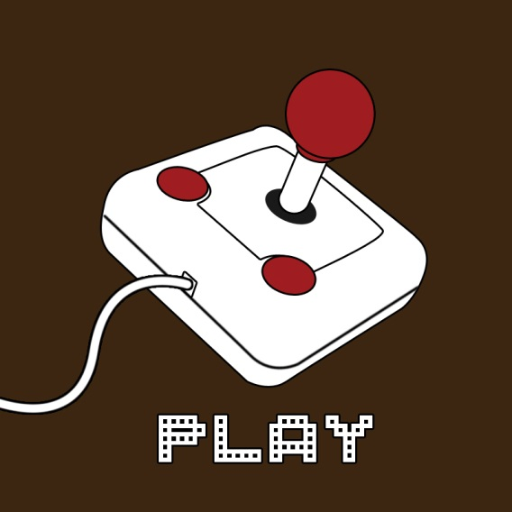
The world according to Elm (2)
Input = (Float, Float)
update :
Input -> Model -> Model
Model
Model
update

Slide 19
A signal is a value that changes over time.

Slide 20


The world according to Elm (3)
Signal Input
update
update
update
update
Signal Model
foldp update startModel input : Signal Model

Slide 21

The world according to Elm (4)
view : Model -> Element

Slide 22

The world according to Elm (4)
Signal Input
Signal Model
Update
Update
Update
Update
view
map view (foldp update startModel input) : Signal Element

Slide 23
main : Signal Element
foldp : (a -> state -> state) -> state -> Signal a -> Signal state
foldp update startModel input

Slide 24
Shapes, Forms, and Elements
Shapes and paths
circle : Float -> Shape
filled : Color -> Shape -> Form
Forms: things with coordinates
move : Float -> Float -> Form -> Form
Elements: what’s actually displayed
collage : Int -> Int -> List Form -> Element
toForm : Element -> Form
flow : Direction -> List Element -> Element
image : Int -> Int -> String -> Element

Slide 25
Shapes, Forms, and Elements
Shape
Element
(what’s actually displayed)
Form
(things with coordinates)
circle : Float -> Shape
filled : Color -> Shape -> Form
collage : Int -> Int -> List Form -> Element
toForm : Element -> Form
move : Float -> Float -> Form -> Form
image : Int -> Int -> String -> Element
flow : Direction -> List Element -> Element

Slide 26
Go make games!
Write down the type signatures of your model and input first! Remember,
update : Input -> Model -> Model
view: Model -> Element
Make a prototype.
Break up into small parts.
Use the examples http://elm-lang.org/Examples.elm and documentation http://package.elm-lang.org/packages/elm-lang/core/3.0.0/
Notes:
In programming, there’s way too many functions to remember. Instead, have a good idea in your head of what you want to do, and then look up the functions/syntax that you need.
http://elm-lang.org/Examples.elm
If you work in groups…
Use the modular nature of functional programming to divide up work!

Slide 27
Go forth and learn!
Ask questions on the elm mailing list.
http://elm-lang.org/community
Elm is based off the functional language Haskell, which has more advanced features.
http://learnyouahaskell.com/
Keep in touch! holdenl@princeton.edu

